Slide 1

        Presented By:-Neeraj Virmani

Slide 2
Sonar
Sonar is an open source platform used by development teams to manage source code quality. Sonar main objective is to make code quality management accessible to everyone with minimal effort.
A platform to manage code quality
Free, open source, LGPL, web-based portal
Aggregates well-known tools
  Static analysis (PMD, findbugs, Checkstyle)
  Duplicate code (Squid, CPD)
  Code coverage (Cobertura, JaCoCo)

Slide 3
Sonar
Sonar provides code analyzers, reporting tools, defects hunting modules as core functionality.
In terms of languages, Sonar support analysis of Java in the core, but also of Flex (ActionScript 3), PHP, PL/SQL and Cobol through plugins (Open Source or commercial) as the reporting engine is language agnostic.
Sonar enables to cover quality on 7 axes and so to report on:
Duplicated code
Coding standards
Unit tests
Complex code
Potential bugs
Comments
Design and architecture

Slide 4
SonarQube Setup
We need 3 components for setting up the SonarQube :-
MySql
SonarQube
Sonar-Runner
Follow the following links for the setup :-
MySql :- https://www.digitalocean.com/community/tutorials/how-to-install-mysql-on-ubuntu-16-04
SonarQube :- http://dev.mamikon.net/installing-sonarqube-on-ubuntu/
Sonar-Runner :- http://dev.mamikon.net/installing-sonarqube-runner-on-ubuntu/#Run_SonarQube_Runner_on_a_sample_source

Slide 5
Install MySql
bash$: sudo apt-get update
bash$: sudo apt-get install mysql-server
Note :- Set password “root” while installation.
bash$: mysql -u root -p
Enter password:
Welcome to the MySQL monitor. Commands end with ; or \g.
Your MySQL connection id is 7
Server version: 5.7.16-0ubuntu0.16.04.1 (Ubuntu)
Copyright (c) 2000, 2016, Oracle and/or its affiliates. All rights reserved.
Oracle is a registered trademark of Oracle Corporation and/or its
affiliates. Other names may be trademarks of their respective
owners.
Type 'help;' or '\h' for help. Type '\c' to clear the current input statement.
mysql>

Slide 6
Create the Database and a User
mysql> CREATE DATABASE sonar CHARACTER SET utf8 COLLATE utf8_general_ci;
Query OK, 1 row affected (0.00 sec)
mysql> CREATE USER 'sonar' IDENTIFIED BY 'sonar';
Query OK, 0 rows affected (0.00 sec)
mysql> GRANT ALL ON sonar.* TO 'sonar'@'%' IDENTIFIED BY 'sonar';
Query OK, 0 rows affected, 1 warning (0.00 sec)
mysql> GRANT ALL ON sonar.* TO 'sonar'@'localhost' IDENTIFIED BY 'sonar';
Query OK, 0 rows affected, 1 warning (0.00 sec)
mysql> FLUSH PRIVILEGES;
Query OK, 0 rows affected (0.00 sec)

Slide 7
Download SonarQube and Setup
Download sonarqube from -: https://www.sonarqube.org/downloads/
wget https://sonarsource.bintray.com/Distribution/sonarqube/sonarqube-5.5.zip
Resolving sonarsource.bintray.com (sonarsource.bintray.com)... 5.153.35.248
Connecting to sonarsource.bintray.com (sonarsource.bintray.com)|5.153.35.248|:443... connected.
HTTP request sent, awaiting response... 302
sonarqube-5.5.zip 100%[===============================>] 112.40M 258KB/s in 9m 24s

Slide 8
Download Sonar-Runner
Download Sonar-Runner from :-
http://docs.sonarqube.org/display/SONARQUBE45/Installing+and+Configuring+SonarQube+Runner
wget http://repo1.maven.org/maven2/org/codehaus/sonar/runner/sonar-runner-dist/2.4/sonar-runner-dist-2.4.zip
Resolving repo1.maven.org (repo1.maven.org)... 151.101.24.209
Connecting to repo1.maven.org (repo1.maven.org)|151.101.24.209|:80... connected.
HTTP request sent, awaiting response... 200 OK
Length: 283337 (277K) [application/zip]
Saving to: ‘sonar-runner-dist-2.4.zip’
sonar-runner-dist-2.4.zip
100%[=========================================================>]
2017-01-11 16:34:04 (31.1 MB/s) - ‘sonar-runner-dist-2.4.zip’ saved [283337/283337]
bash: $ ls
sonarqube-5.5.zip sonar-runner-dist-2.4.zip

Slide 9
SonarQube Setup
Steps to setup :-
Unzip the zip file and move to /opt directory , rename to sonar.
bash$ : unzip sonarqube-5.5.zip
bash$ : mv sonarqube-5.5 /opt/sonar
Edit sonar.properties :-
bash$ : vi /opt/sonar/conf/sonar.properties
Modify the following lines:-
sonar.web.host=127.0.0.1
sonar.web.context=/sonar
sonar.web.port=9000

Slide 10
SonarQube Setup
Implement SonarQube server as a service :-
bash$ : sudo vi /etc/init.d/sonar
Insert two new lines:-
SONAR_HOME=/opt/sonar
PLATFORM=linux-x86-64
Modify the following lines:-
WRAPPER_CMD="${SONAR_HOME}/bin/${PLATFORM}/wrapper" WRAPPER_CONF="${SONAR_HOME}/conf/wrapper.conf"
PIDDIR="/var/run"
Register SonarQube as a Linux service:-
bash$ : sudo update-rc.d -f sonar remove
bash$ : sudo chmod 755 /etc/init.d/sonar
bash$ : sudo update-rc.d sonar defaults

Slide 11
Sonar-Runner Setup
bash$: unzip sonar-runner-dist-2.4.zip
bash$: mv sonar-runner-2.4 /opt/sonar-runner
Edit sonar-runner.properties :-
bash$: vi /opt/sonar-runner/conf/sonar-runner.properties
Uncomment the following lines :-
sonar.host.url=http://localhost:9000/sonar
sonar.jdbc.url=jdbc:mysql://localhost:3306/sonar?useUnicode=true&characterEncoding=utf8
sonar.jdbc.username=sonar
sonar.jdbc.password=sonar
Create a file and set enviornment variables :-
bash$: vi ~/.pam_environment
Add the following lines to it:
SONAR_RUNNER_HOME=/opt/sonar-runner PATH DEFAULT=${PATH}:${SONAR_RUNNER_HOME}/bin

Slide 12
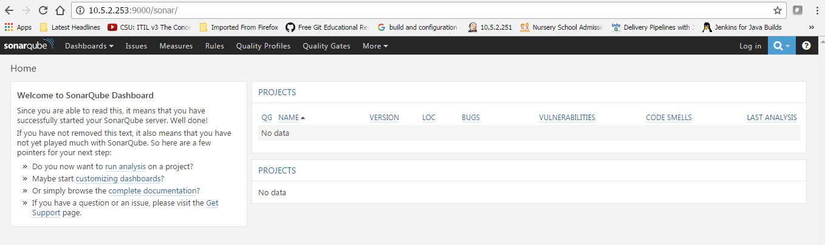
Start SonarQube
bash:$ sudo /etc/init.d/sonar start
Starting SonarQube...
Started SonarQube.

Slide 13
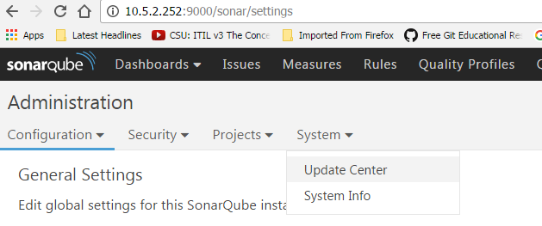
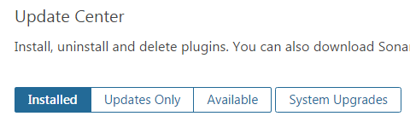
Install Plugins
Go to Administration -> System -> Update Center
Click on Available -> Install desired plugins

Slide 14
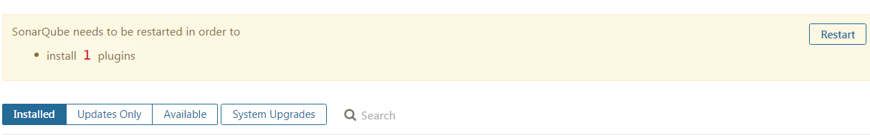
Install Plugins
After selecting the plugin , Restart the SonarQube to take effect

Slide 15

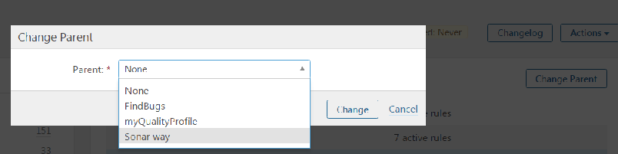
Quality Profile
Quality Profiles :- Quality Profiles are collections of rules to apply during an analysis. For each language there is a default profile. All projects not explicitly assigned to some other profile will be analyzed with the default.
Create a Profile :-

Slide 16
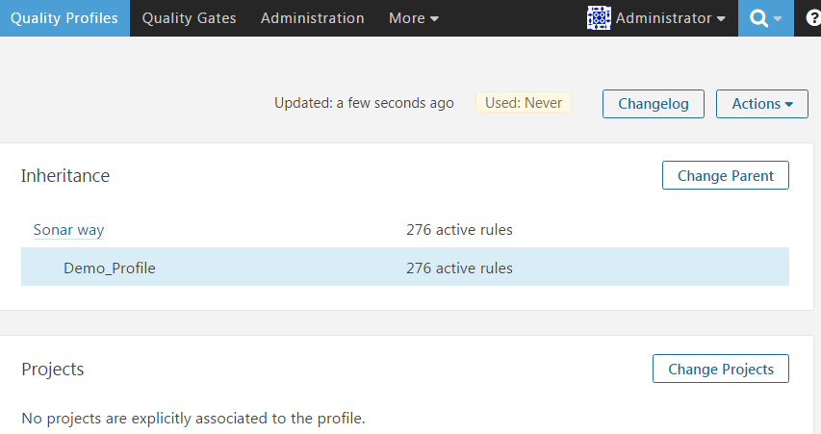
Quality Profile
Associate Projects with Quality Profile :-

Slide 17
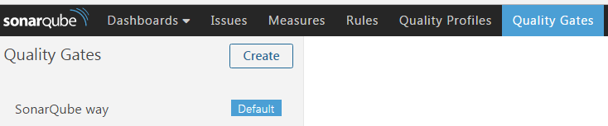
Quality Gates
Quality Gates are collections of simple boolean thresholds set on project measures. A project must pass each of the thresholds in order to pass the Quality Gate as a whole.
It is possible to set a default Quality Gate, which will be applied to all projects not explicitly assigned to some other gate.

Slide 18
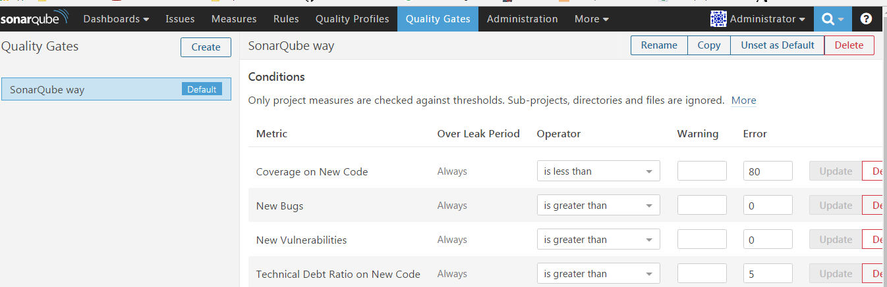
Quality Gates

Slide 19
Technical Debt
Term coined by Ward Cunningham in 1992
Work that needs done before a job is complete
    Unwritten tests
    Bad design and architecture
    Duplicated code
    …
The higher you wait to fix, the more expansive it becomes

Slide 20
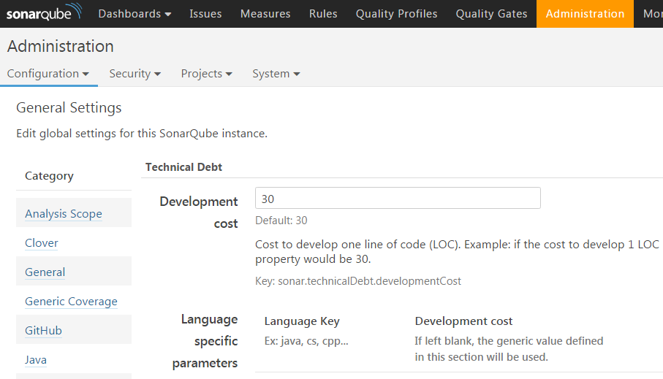
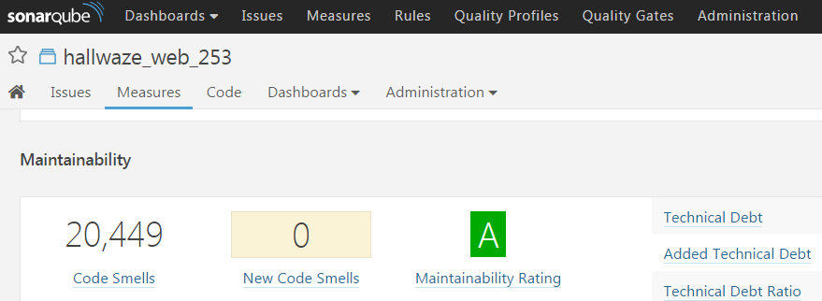
Technical Debt

Slide 21
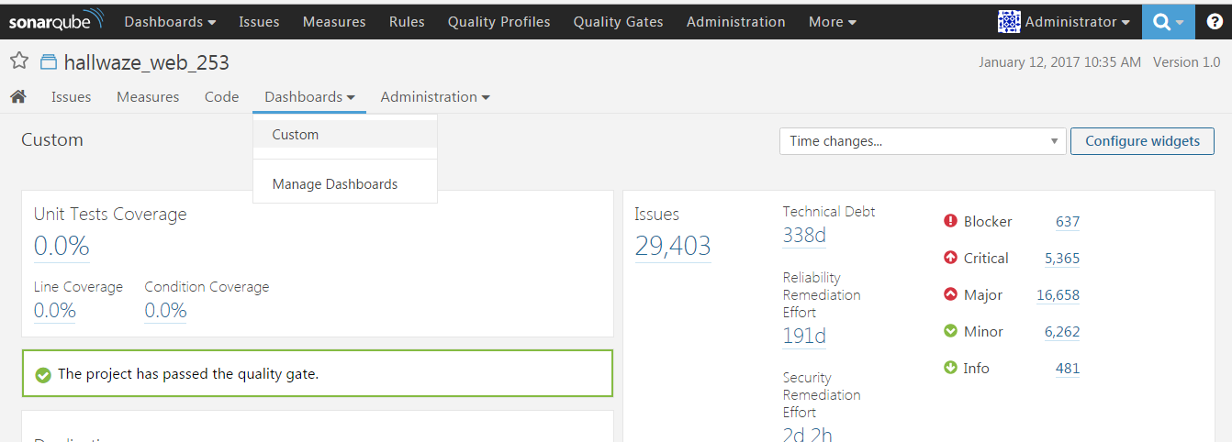
Dashboard
Most useful feature providing insight to whole Analysis :-

Slide 22
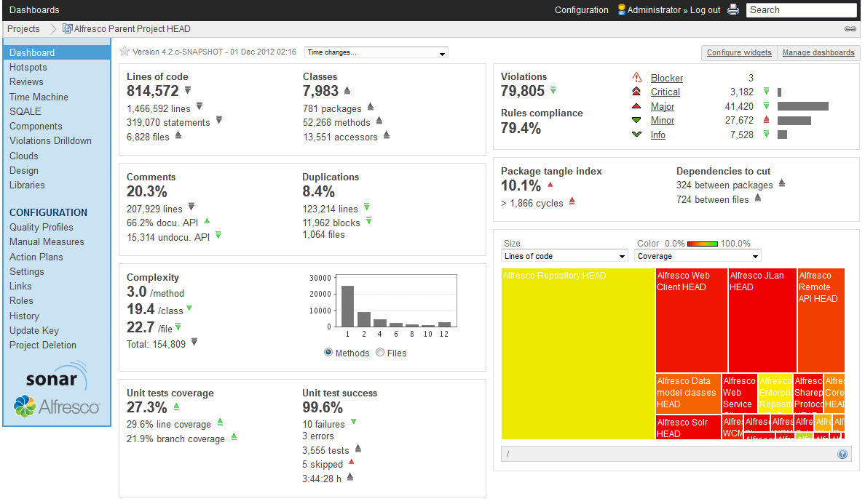
Dashboard
Slide <number>

Slide 23
Dashboard - Basic statistics

Slide 24
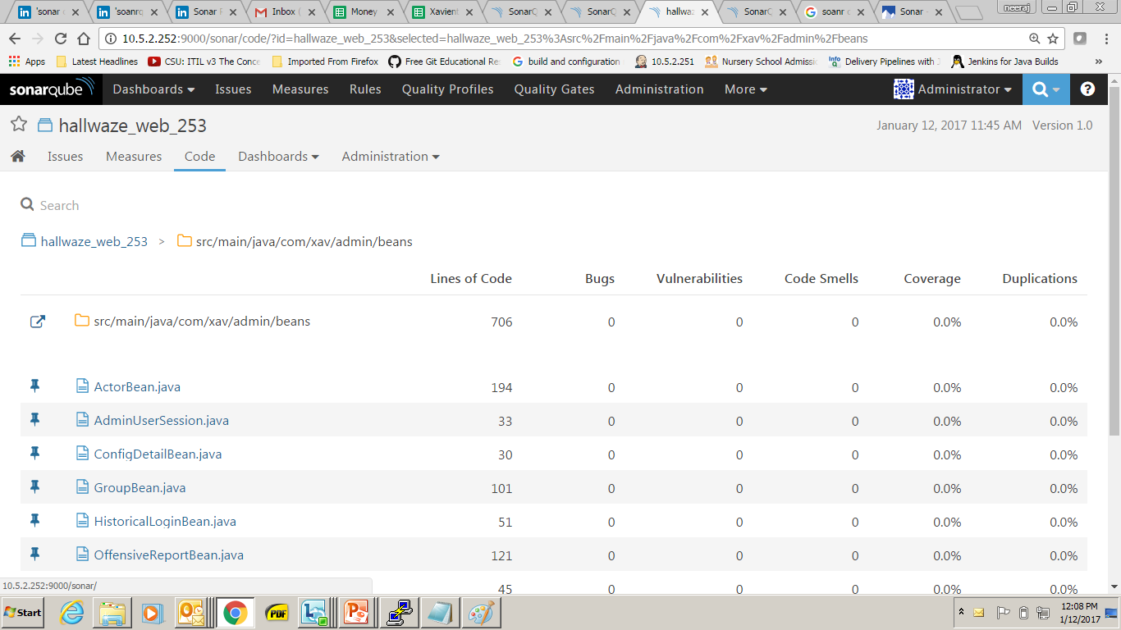
Drill down in statistics

Slide 25
Sonar Property File
sonar-project.properties file is kept under the base directory of the project, It has the information of the project and SonarQube required to execute the sonar-runner and create the statistics.
E,g,
sonar.host.url=http://10.5.2.252:9000/sonar
sonar.projectName=Project_Name
sonar.projectVersion=1.0
sonar.projectKey=Project_Name
sonar.sources=src
sonar.projectBaseDir=.
sonar.java.binaries=target/classes

Slide 26
Execution of Sonar Runner
Execute the Sonar Runner to create sonar reports.
bash $ sonar-runner -X
SonarQube Runner 2.4
Java 1.8.0_111 Oracle Corporation (64-bit)
Linux 4.4.0-31-generic amd64
INFO: Error stacktraces are turned on.
INFO: Runner configuration file: /opt/sonar-runner/conf/sonar-runner.properties
INFO: Project configuration file: /var/demo/web/sonar-project.properties
INFO: Default locale: "en_IN", source code encoding: "UTF-8" (analysis is platform dependent)
INFO: Work directory: /var/demo/web/./.sonar
INFO: SonarQube Server 6.0

Slide 27
THANK YOU

